Slide 1
Trees
A Graph that is Connected and Acyclic
Programming – Code Design & Data Structures

Slide 2
Contents
What Are Trees
Where Are Trees Used?
Terminology
Components of a Tree

Slide 3
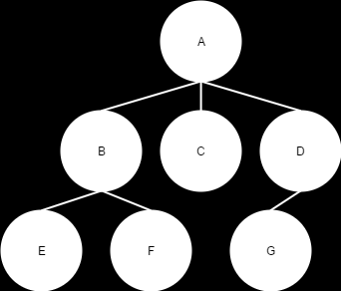
What are Trees
A tree is a type of directed graph
A minimally connected graph
means that all edges are necessary to make the graph one big connected graph
The number of edges in a tree is the number of nodes minus one
Only one path between any two nodes
A tree starts with a single root node
Each node exists only once within the tree

Slide 4
Where Are Trees Used?
Binary Space Partitioning (BSP trees)
Sorts the polygons in a game level to allow back-to-front rendering
First used in Doom (the 1993 one)
Decision Trees and Behaviour Trees
Both are commonly used in Artificial Intelligence
Monte-Carlo Search Trees
A method for making optimal decisions in AI
Binary Search Trees
An efficient approach for searching ordered data
Data Formats
XML and JSON are popular data formats that use a tree structure

Slide 5
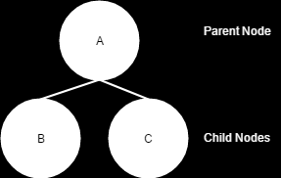
Terminology
Each node, apart from the root node, must have one and only one edge leading into it
The node at the other end of that edge is known as the parent
Each node, including the root, can have multiple edges leading from them
The nodes at the other end of these nodes are known as children

Slide 6
Components of a Tree
A Tree graph is usually drawn upside down when compared to a real-world tree
The first node in the tree is the root and is located at the very top
Nodes without any child nodes are usually referred to as leaves
Nodes with child nodes are called branches
A sub-tree is a part of the tree that, if removed, would form a tree on its own.

Slide 7
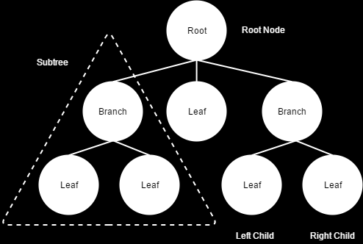
Components of a Tree

Slide 8
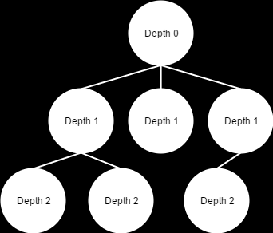
Components of a Tree
Nodes in a Tree have
Depth: the distance of a node from the root node
This is also sometimes referred to as the level of a node

Slide 9
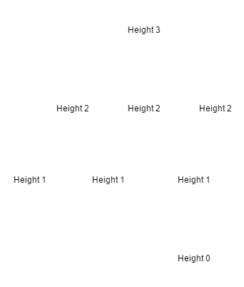
Components of a Tree
Nodes in a Tree have
Height: is the number of nodes from the current node to the deepest leaf node in that branch

Slide 10
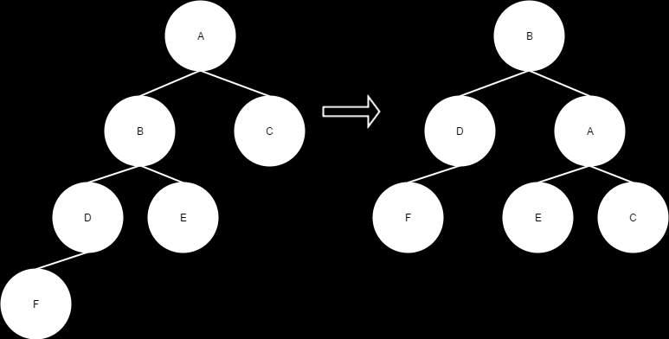
Balanced Trees
A Tree is considered balanced when the height of its subtrees differ by no more than 1
Balanced trees are more efficient to search than unbalanced ones
There are methods to rebalance a tree, but these can be quite complex

Slide 11
Tree Graph Uses
Like a normal graph, a tree’s main use is not for storage
Trees are a great way for representing hierarchical data
The bones in a skeleton in computer graphics
Spatial layout of a game level
The entire level is under the root node, divided into sub-trees representing areas of the level, each with more sub-trees representing the game entities within those areas
XML documents
Scene Graph – Parent/Child hierarchies within objects

Slide 12
Summary
Trees are used in a wide range of applications (both within games and the broader software industry)
You’ll find trees used in spatial partitioning, scene graphs, animation, artificial intelligence, file formats, and in a range of other applications
Nodes in a tree can be a root node, branches or leaves
There is only one root node in a tree
Trees are connected, acyclic graphs
All nodes are connected, and there are no loops

Slide 13
References
Allen Sherrod, 2007. Data Structures and Algorithms for Game Developers (Charles River Media Game Development). 1 Edition. Course Technology PTR.

